Slide 1
ENSE 470 - Milestone 1
Group Name: GGWP
Group Members:
Vincent Chan
Thiago De Melo
Shuaihao Zhao
Joe Emmanuel Samano
January 18, 2018

Slide 2
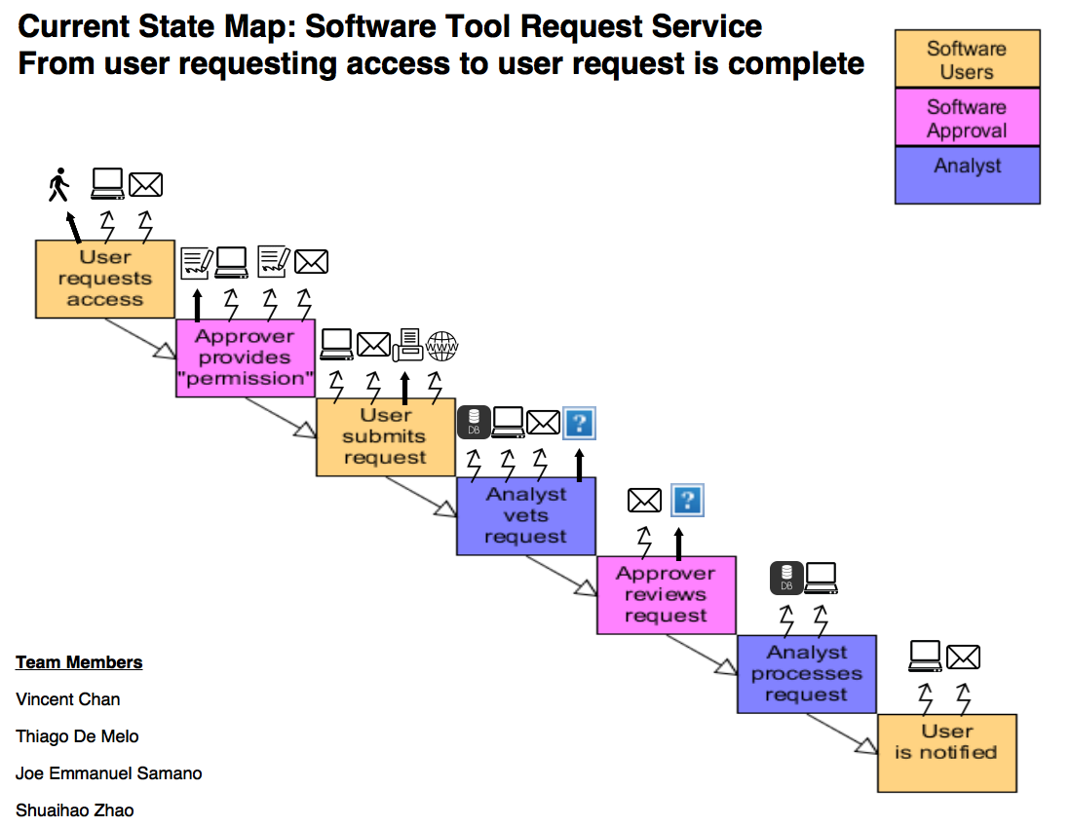

Slide 3
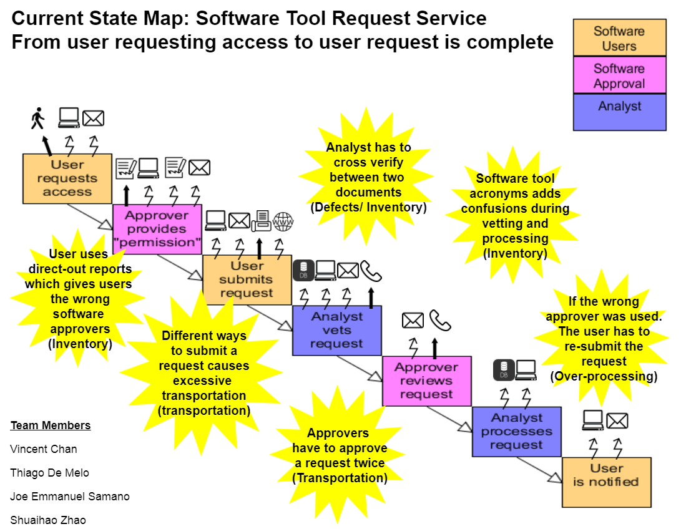

Slide 4
Group Reflection
How did you feel about this milestone? What did you like about it? What did you dislike?
At first, when we read the whole project, it was overwhelming and hard to understand since this is our first milestone. It was very useful because it helped simplify and understand the whole project. We had to redo it a few times.
What did you learn about yourself as you collaborated and worked through this milestone?
What we learned is that everybody has different interpretations and point of views on the project. We could use these different ideas as an advantage, so when we worked and put our ideas together, we were able to understand the project a lot better and we were able to build a current state map that we as a group agreed on for this milestone.
How will you use what you have learned going forward?
We could use this experience to apply in our future projects like identifying real problems in order to reduce waste that were discussed in class.
If you search for solutions, you might find solutions for problems that doesn’t exist.

